Slide 1




Gendorf, Germany
Operations Excellence
Assessment Report
March 30, 2020
Company 328
Revenues €143 Million / yr
EBITDA €9.1 Million / yr
EBITDA %Rev 6.3%
Cards,
Construction
Cooling Tower
Decorative
Roll Sleeve
Shrink Sleeve
Stationary
Tape
Gendorf

Slide 2
Observations
General Findings
The Organization is open to change with a relatively solid leadership team, the site has a lot of strengths (more than other sites visited so far) that can be leveraged, and the site has a lot of potential.
STRENGTHS
OPPORTUNITIES
ASSET UTILIZATION/ TECHNOLOGY
TEAM - Skilled capable people who seem to work as a team
ASSETS - Assets are generally in better condition and some key money makers – E27, K10, K17, K40
CULTURE - Culture that seems open, willing to change and is more disciplined and process / methods focused
IMPROVEMENT - The site has a lot of improvements underway – build upon and take to next level – Visual Factory, SOS
PRODUCT MARGIN OPTIMIZATION - Improving Business and Operations Integration to collectively improve Product Margins
HIDDEN PLANT – Leverage Lean / 6Sigma / Reliability to reduce downtime due to changeovers, cleaning, maintenance unplanned and planned – Consolidate products and lines
OPERATIONS EXCELLENCE – Team has started some good practices but there is still a need for more best practices.
The site has some technology that is relatively new and state of the art such as E27 as well as older technology that is underutilized E26, E28, and K06
The site is also positioned for cost effective expansion at the E27 location
Robotic Packaging line (which appear overdesigned) is also present on site.
The site has moved to sharing crews across lines to accommodate underutilization.

Slide 3
Observations
General Findings
ORGANIZATION
EXPECTED CASE
New leadership is establishing more decision-making and engaging the shop-floor. The new leader and new approach are well received. There are some legacy challenges due to the command and control style of the previous leader. Insight: Leadership should stop wearing red jackets to help eliminate the “us and them” that has existed for a while.
The OPEX / Continuous Improvement Organization and Operations appear to have some overlapping responsibilities when it comes to day to day operating support. Insight: The Production Specialists currently reporting into Continuous Improvement should be re-integrated into operations in order to more clearly define who is responsible for Strategic Improvement vs Daily Operating Support. OPEX / CI needs to focus on defining clear improvement projects and have stronger skills at managing projects and allow operations to take ownership of day to day support.
OPEX, Supply Chain and EHS have a good start on a site 3-5-year plan Insight: This should be leveraged across the entire organization to build a more comprehensive set of goals, objectives and plans.
€ 6-8 MILLION / YR
STRETCH CASE
€10-13 MILLION / YR

Slide 4
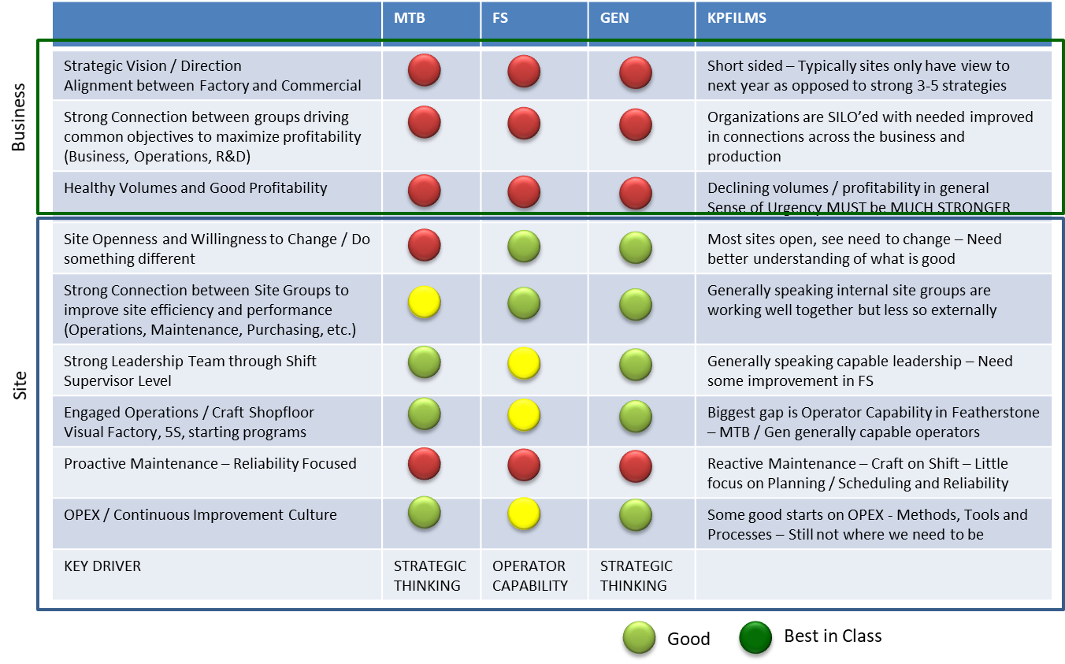
KPFilms – Common Themes
The table below shows common themes across KPFilms sites visited so far.
Key Message:
Across the board, there is a need for a better connection between the business team and manufacturing. The teams are SILOed, short sided and reacting to the market vs planning, taking a position and driving shared profitability. While Montabaur and Gendorf need to work more closely with the business to strategically define business/manufacturing direction, Featherstone needs to focus on basic fundamentals around Operating Discipline and building operator capability.

Slide 5
Summary Recommendations – EST. IMPACT
EST. IMPACT
EST. IMPACT
EST. IMPACT
€3.5 – 6.0 Million / YR
€2.0 – 4.0 Million / YR
€1.5 – 3.0 Million / YR
PRODUCT OPTIMIZATION
ASSET PERFORMANCE
OPERATIONAL EXCELLENCE
There appear to be a fair number of low to negative margin products that should be reviewed.
All the groups, business, manufacturing, supply chain need to work together to improve these margins by using a combination of potential levers:
Price Increase
Production Rules
Minimum Order Sizes
Campaigning
Unutilized capacity should be monetized.
If sales can not come through with additional volumes, Lines such as E26, K06 should be considered for Consolidation. There is evidence to suggest that consolidating these lines into higher performing lines is possible
Since there are other unutilized assets across the KPFilms network, Gendorf should work with sister sites (Montabaur) to consolidate under utilized lines.
Site has little choice but to find ways to significantly reduce costs and gain efficiency. The site has started to challenge existing paradigms but still has underlying Command / Control culture.
Shop floor must fully engage and take ownership for real cost savings to begin.
Maintenance & Reliability are opportunities and are in need of Best Practice.

Slide 6
Summary Recommendations
PRODUCT MARGIN OPTIMIZATION / COMMERCIAL
WHAT THINGS NEED TO BE CONSIDERED TO IMPROVE BUSINESS?
RECOMMENDATION
EST. IMPACT
There appear to be a fair number of low to negative margin products that should be reviewed. All the groups, business, manufacturing, supply chain need to work together to improve these margins by using a combination of potential levers:
Price Increase, Production Rules, Minimum Order Sizes, Campaigning, etc.
€3.5– 6.0 Million / YR
FINDINGS
The site produces a wide variety of specialties products – Businesses appear to range from low margin one off (Ex: Cooling Tower) to Cash Cow (Ex: Tape) to growth businesses (Ex: Deco and Shrink Sleeve).
Approximately 33% of the volume is new products particularly in Deco and Shrink Sleeve. This contributes to a long tail of products that have relatively low margin and low volume. Considerations should be made to ensure minimum order sizes as well as tracking how many new products actually become full production products. It is best to isolate new products to specific lines so that larger money-making lines such as E27 are left undisturbed.
There are roughly €4.8 Million in Product Rebates – This is a huge opportunity for Commercial and Manufacturing to work together to reduce Customer Rebates due to Off-spec, complaints, etc. A single base product within the Tape (PVC-240/15-TL) has the most volume across the plant yet has double the rebates (8% Revenue) of most other products (€1.6 Million in Rebates). This rebate consumes 84% of the profitability the product would have had without the rebates.
There is a significant opportunity for the Business and Manufacturing teams to work more closely together to fully understand product and line profitability. Every product and customer should be reviewed with Operations to find opportunities to optimize margin – Examples: Production rules on certain products running only on certain lines, Economic Batch sizes, Minimum order sizes, Campaign vs Short Cycles, Packaging options, customer service levels, etc.

Slide 7
Summary Recommendations
ASSET PERFORMANCE - HIDDEN FACTORY
CAN WE GET MORE OUT OF EXISTING ASSETS?
RECOMMENDATION
EST. IMPACT
Unutilized capacity should be monetized.
If sales can not come through with additional volumes, Lines such as E26, K06 should be considered for Consolidation. There is evidence to suggest that consolidating these lines into higher performing lines is possible
Since there are other unutilized assets across the KPFilms network, Gendorf should work with sister sites (Montabaur) to consolidate unutilized lines.
€2.0 – 4.0 Million / YR
FINDINGS
Gendorf has a mix of Technologies and vintages across their assets. Insight: newest and most state-of-the-art line is E27 & K17 are the best-run lines with stable yield, uptime, and rate performance relative to the others – K40, E26, E28, K10 appear to have the most upside opportunity.
Priority for capturing increased asset capability should be on Lines E27, E40 - This will take a sharper focus on true continuous improvement. The organization tracks daily operating parameters, but there does not appear to be a concerted effort with a project mentality on thinking in strategical improvement terms to capture hidden plant opportunities (increases in yield, uptime and rate). Insight: The organization requires a more apparent separation between OPEX/CI (Strategic) and Operations (Tactical)

Slide 8
Summary Recommendations
OPERATIONAL EXCELLENCE
ARE THERE OPPORTUNITIES TO REDUCE COSTS?
RECOMMENDATION
EST. IMPACT
Site has little choice but to find ways to significantly reduce costs and gain efficiency. The site has started to challenge existing paradigms but still has underlying Command / Control culture.
Shop floor must fully engage and take ownership for real cost savings to begin.
Maintenance & Reliability are in need of Best Practice
€1.5 – 3.0 Million / YR
FINDINGS
Opportunities to reduce cost are relatively limited but do exist.
Maintenance is high cost and reactive – although there are PM/PdM maintenance activities – a focused reliability program is still lacking. Maintenance is currently performing a lot of non-maintenance activities that should be done by operations
Insight: Site needs to clarify expectations with regards to non-maintenance activities. Roles such as Maintenance Gatekeeper and Reliability need to be considered.
Operations – Work crews appear to be somewhat flexible but there is likely still opportunity here. The most significant OPEX opportunity is to clearly define technical roles responsible for day-to-day troubleshooting and functions for Strategic Improvement. Insight: Production Engineers or similar within production should be responsible for day to day troubleshooting and a Process Improvement Engineering within OPEX/CI should be responsible for establishing a stretch goal for the assets, then defining and implementing projects to make it happen.

Slide 9
Summary Recommendations
ABCD ANALYSIS REVIEW
Currently, Gendorf has an ABCD strategy to energizing the team to action. The conclusions in this report align with the ABCD with a few minor enhancements. The new leadership has made a favorable impression, but there are still a lot of things to get done.
There needs to be a stronger link to working out a strategy and improving product profitability with other groups Commercial, R&D, Operations, etc. The site is working to reduce SILO’s but is still SILOed.
Maintenance is a strong team, but reactive - Maintenance Costs are a cost reduction opportunity, and Reliability has just started.
Building accountability in the organization will take more engagement of the shopfloor. Leadership needs to release decision rights more. As we discussed at the site, leadership needs to stop wearing red jackets as it sends unintentional signals.

Slide 10
Gendorf – Actions which can be started now
The following is a list of immediate actions that we discussed at the Site Visit.
PRODUCTION
Start regular alignment talks between supply chain, business, and operations to strengthen the S & OP process.
The 4 OPEX manufacturing specialists should be re-integrated into the production team.
A more significant focus on a continuous process improvement process would help to speed-up the site performance.
The site has excellent 6Sigma expertise; this should be reactivated – There are several good candidates for project leads among this group. This approach would strengthen the overall project implementation process.
The technical customer support is often not good enough to resolve customer topics quickly. This issue needs to be clarified regarding roles and responsibilities.
MAINTENANCE
Recommendation to change 35.5 hr. contracts to 37.5 hr. or 39.5 hr. contracts for those employees who want to do this.
Planning and scheduling for maintenance FTE´s: The maintenance employees should do true maintenance activities only.
Start with a self-planning tool for maintenance employees and incentivize the use of it.
Have 5S and lean activities done more by employees themselves or create a “Moonshine Team.”
Ensure that the maintenance FTE´s are scheduled for 100% of their working time.

Slide 11
Summary Recommendations
Product Margin Optimization / Commercial Considerations
Asset Performance Analysis
Cost Reduction Opportunities
Operations Excellence Best Practices to Consider
Much of the following analysis is located on the following secure website:
http://gendorf.herokuapp.com/

Slide 12
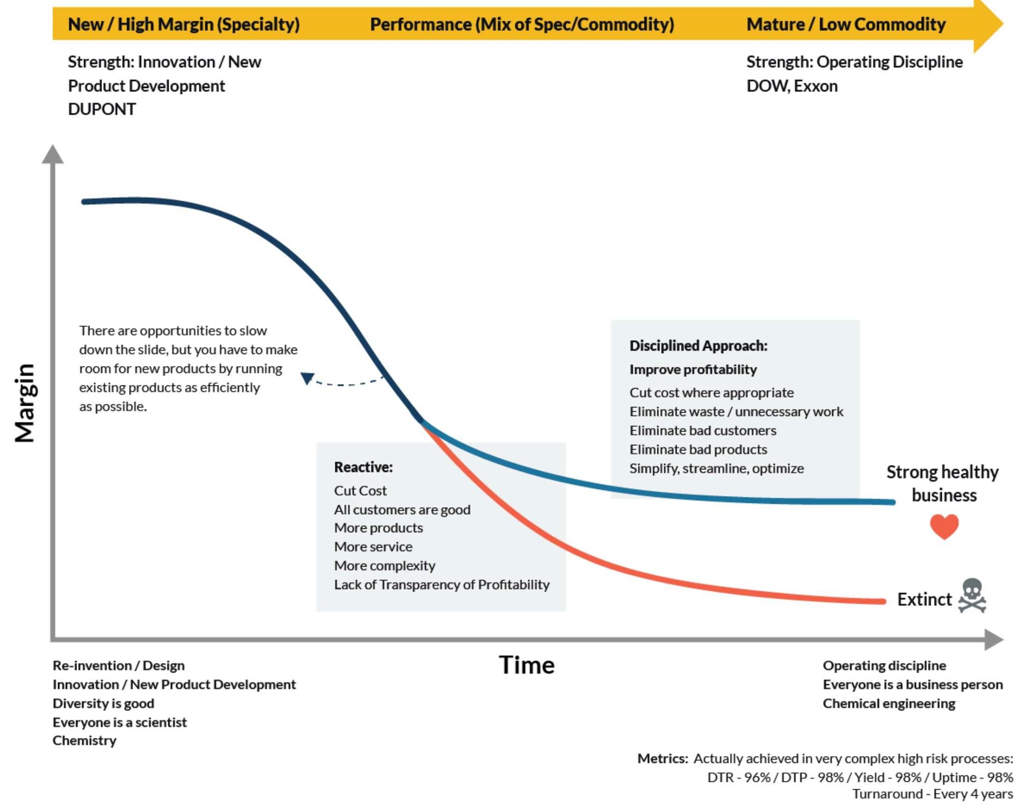
Product Margin Optimization / Commercial Considerations
What appears to be happening to the KPFilms businesses.
HIGH MARGIN– More likely to justify service, small volumes,
FLEXIBLE PRODUCTION
INNOVATION AND CUSTOMER SERVICE LEAD
NOTE: All products eventually follow this path. Not all customers and products can be treated the same. The secret is constantly differentiating customers and products and moving them strategically to an operating discipline approach as they commoditize
Different Products and Businesses at a Site can be in different parts of the life cycle and may have different needs
Deco
MED – position for commoditization – start consolidating
Shrink Sleeve
Tape
LOW MARGIN - in need of radical challenge of cost
Large Volumes-Large Lines
OPERATING DISCIPINE AND COST LEAD
Construction
Cards
The secret to successfully improving margin as volume or price is reduced is to work holistically with the business, supply chain, production, etc to find creative solutions together. Working in SILO’s no longer works.
Slide 3

Slide 13
Product Margin Optimization / Commercial Considerations
Product Margin – Rank Order by EBITDA Graph
Key Takeaway: The Gendorf site has a lot of Product Complexity in which the business is getting little value. The Top 32 Products out of 158 Products (data provided) represents 133% of the EBITDA. There is a need to challenge negative margin products and work together across business, manufacturing, supply chain, finance to optimize / improve margins.
TOP 20% Products Represent 133% of EBITDA
And 70% of Volume
€12.2 Mil EBITDA
32 Products
MIDDLE 20% Products Represent 13% of EBITDA
And 9% of Volume
€1.2 Mil EBITDA
90 Products
BOTTOM 20% Products Represent (43%) of EBITDA
And 21% of Volume
-€4.3 Mil EBITDA
32 Products
33% New Products

Slide 14
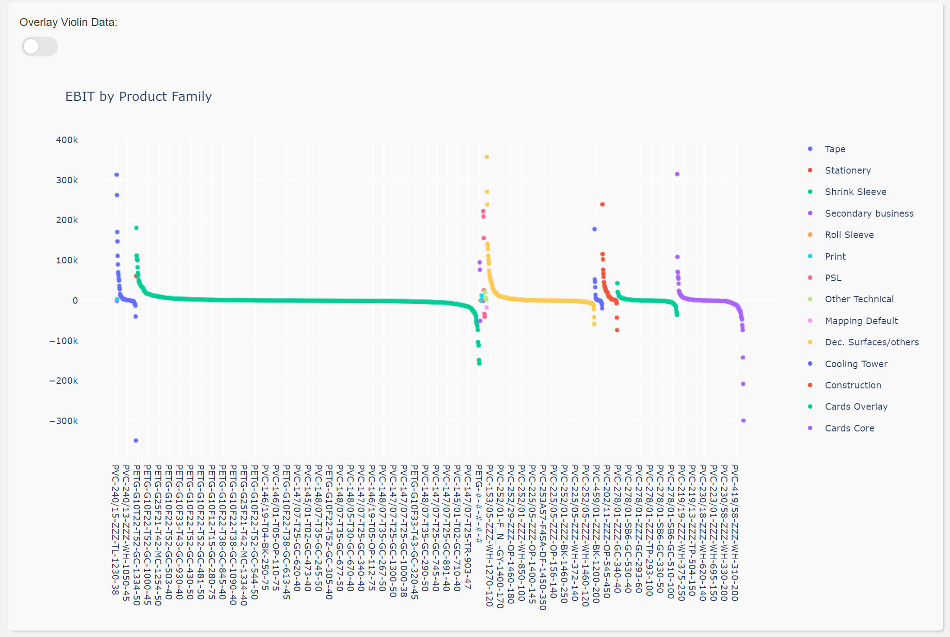
Product Margin Optimization / Commercial Considerations
Product Margin – broken down by Product Family and graphed in Rank Order
Estimated Profitability by Product Family
Key Takeaway:
Product Margin graph organized along product families shows negative EBITDA tails within the families. This should lead to more discussion between Commercial and Operations on how best to improve the margins of the all the products with a product family.
Neutralizing the Negative Margin Products is worth €4.3 Million / yr.

Slide 15
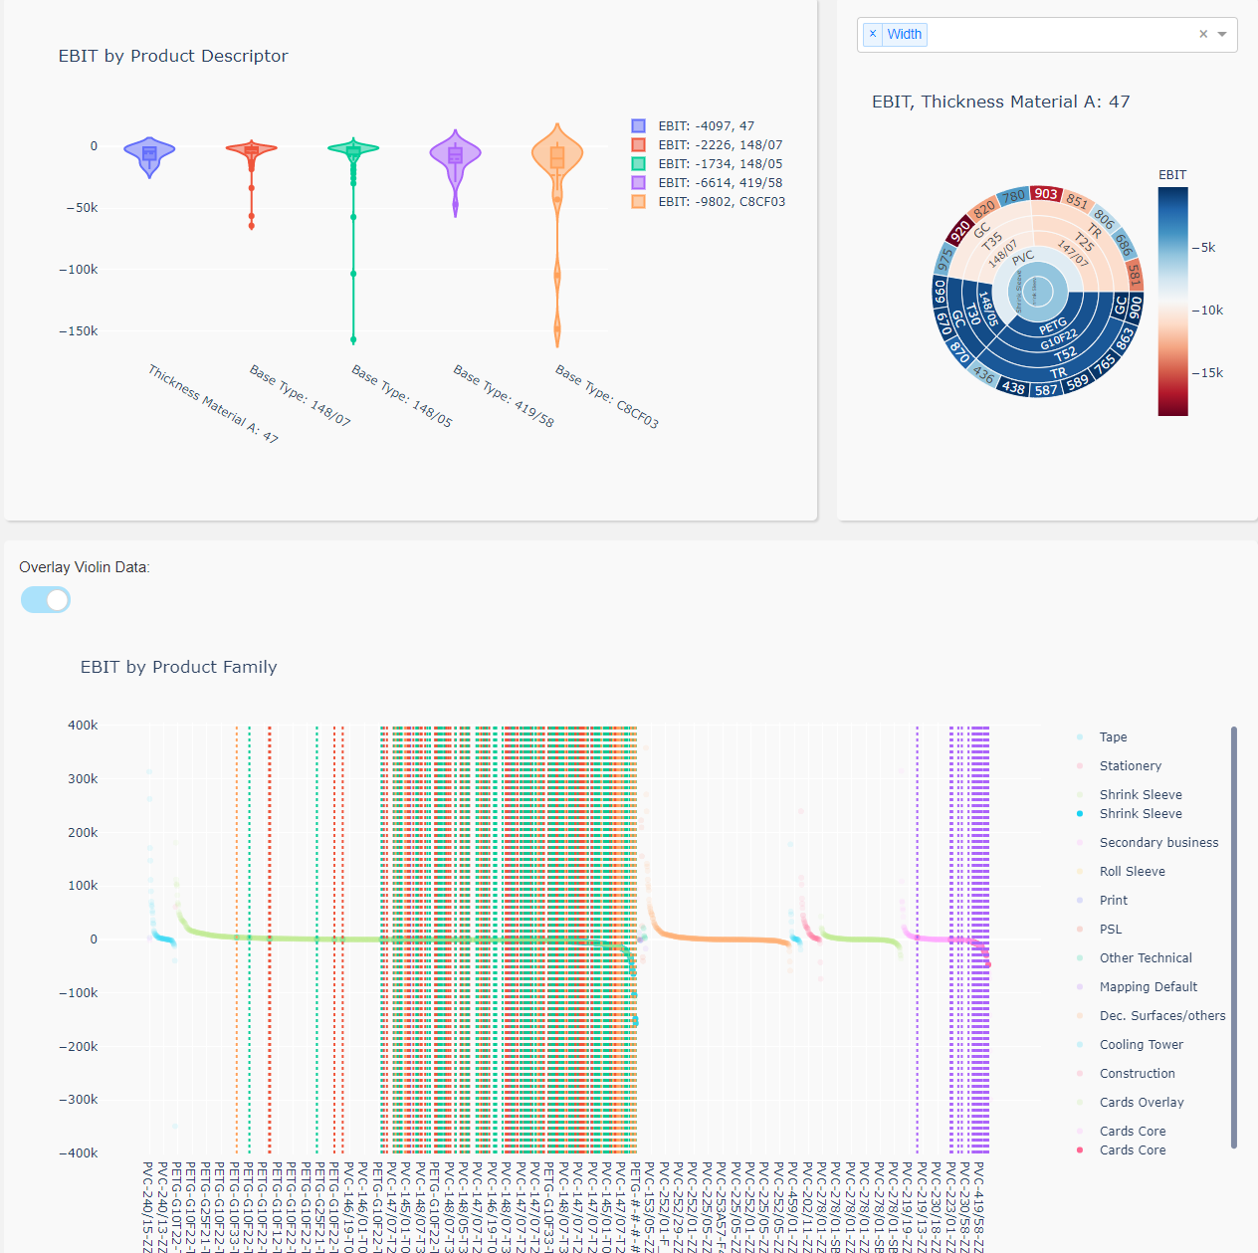
Product Margin Optimization / Commercial Considerations
What are the Top 5 attributes I seem to lose the most money on?
Breakdown the distribution for a particular attribute
Key Takeaway:
An analysis can be done not only on products but also on attributes such as special treatments or thickness, etc. to determine if pricing is appropriate and whether product margins can be optimized.
Where do the Top 5 worst attributes show up on my Product Profitability curve?

Slide 16
Commercial Considerations
Tapes
EBITDA Approx. €1,370k
VOLUME (KG) 9,510,854
Runs exclusively on line K17
1 product appears to be 90+% of Volume
Cash Cow business with few Customers
Highest Volume in plant has 8% Rebates
(More than Double Ave) - (€1,644k)
PVC-240/15-TL – 84% of Profitability given back to Customer due to Rebates
Cards Core
EBITDA Approx. (€297k)
VOLUME (KG) 4,883,300
77% of Volume has negative margin
PVC-240/15-TL – 84% of Profitability given back to Customer due to Rebates
Key Negative Margin Products
PVC-419/58 WH - (€214k)
PVC-230/18 WH - (€254k)
PVC-230/58 WH - (€667k)
Shrink Sleeve
EBITDA Approx. €1,889k
VOLUME (KG) 25,635,846
37% of Vol has Negative CM
PVC on K06 loses a lot of Money
Long tail of low to negative CM products
Neutralize Negative Margin
Key Negative Margin Products
PVC-148/07 GC - (€430k)
PVC-148/05 GC - (€514k)
PVC-147/07 GC - (€720)
Deco
EBITDA Approx. €3,528k
VOLUME (KG) 4,715,808
Long tail of New Products – PVC vs PET/PO
PET and Polyolefins perform poorly
Evaluate Pricing on PET & PO or migrate customers to PVC depending on market
Need to take a position on PVC vs PET/PO
Operations team work to stabilize PET & PO Products
TAPES
Recommended Strategy:
CASH COW = REDUCE COST
Evaluate Rebate Strategy
Operations focus on Cost Reduction
K17 is a relatively good performer – Yield 95%
As price pressure continues on commodity tape – team will have to maintain service, work to retain customers and find ways to reduce cost.
CARDS CORE
Recommended Strategy:
NEUTRALIZE LARGE VOL OF NEG EBITDA
Challenge all Negative Margin Products and Volume
Commercial lead to improve pricing with Customers or Reduce Customers to profitable.
Main line appears to be K10 with support from K18.
Operations team needs to focus on Card Products with low yield and high variability
SHRINK SLEEVE
Recommended Strategy:
KEY IS E27
Challenge all Negative Margin Products and Volumes
K06 PVC is underutilized likely causing part of negative margin on PVC products – Need to grow or consolidate toward PET
OPEX / CI / Reliability define debottleneck projects for E27
E27 daily performance toward migrating E28 & E26 to E27.
Challenge Need for Lines E26 & K06
DECO
Recommended Strategy:
BETTER K40 PERFORMANCE
Challenge all Negative Margin Products and Volumes
Poorest performing products appear to be PET or PP. Pricing strategy?
Line K40 appears to be main line for DECO with support from K18 / K10
K40 appears to have yield and rate opportunities. CI/OPEX need to define projects to capture K40 hidden plant

Slide 17
Product Margin Optimization / Commercial Considerations
Key Takeaways | Impact
Business, Operations, Supply Chain (all groups within the site) need to develop a 3-5 year business plan that establishes product positioning in the marketplace along with optimized ways to run those products on the various lines. Establish pricing, costs, yield & rate expectations, minimum order sizes, production line assignments, etc. These rules and agreements will change as the market conditions change in addition they will vary from business to business. The business needs to take a point of view as to where they see a set of products or businesses heading over this 3-5 year time horizon. The manufacturing team should work to develop profitability optimization scenarios. The site could use a Manufacturing Business Analyst role to help connect the P&L more directly as to what is happening in the plant. | Critical to Sustainability and Enabling Capture of Items 2-5
There is evidence of long product tails as well as substantial volume that has a negative EBITDA. The commercial and operations team should work through a process to understand why this is the case and work through ways to overcome this – The negative tails are worth 4.3 Million / yr. | €2 - 4.3 Million / YR
There is evidence of substantial rebates – some of this is caused by poor product quality and customer complaints. The organization could use a better follow up process for customer complaints and RCA on poor quality. Rebates for 2019 were 4.8 Million / yr. Target should be reduce by 1.5 Million / yr | €1 - 1.5 Million / YR
There are a lot of new products in the system (33%) – Based on our review of the new product process it appears that there needs to be more integration between Product Development and Operations. There appears to be some confusion over when does Product Dev stop supporting production – the relationship appears to be transactional such as “after 3 times = operations problem” vs. one based on long term ownership of a product portfolio with common incentives and a common strategy. | €0.25 - 0.5 Million / YR
There are some business such as Cooling Tower, Cards, Stationary, Print that have very low margins and low volumes – These business should be challenged – Top Priorities for the teams should be growing Shrink Sleeve and Deco and maintaining cash cow businesses like Tape. | €0.25 - 0.5 Million / YR
Combined Expected Goal for Commercial, Operations, R&D, Supply Chain to capture together: | €3.5 – 6.0 Million / YR

Slide 18
Product Margin Optimization / Commercial Considerations
Product and Site Profitability should be a shared objective now and into the future.
Aligned 3-5 Year Strategy
Regular meetings to own the product platform through product life cycle – Deciding together what products to grow, which to retire and how best to produce.
Common and / or Aligned Incentives
R&D - Product Development
Develop New Products
Commercial
Sell and Deliver Products to Customer
Operations
Produce Products to Specification
Key Takeaway:
Best in Class companies see a dynamic relationship and shared responsibility between various groups to regularly own product profitability. The current relationships between different groups at Gendorf (Commercial, R&D, operations, etc.) seem SILOed and transactional.

Slide 19
Product Margin Optimization / Commercial Considerations
Product Margin Optimization
The following process or something similar along with a Facilitator should be used to work with cross functional teams (Business, Operations, R&D, SC, etc.) to optimize product margins. A cross functional team is critical to ensure transparent understanding of all aspects of manufacturing thru selling the product. (Ex: Product could be highly profitable but extremely difficult to make). Many companies believe that the business is solely responsible for optimizing product margins – this is a mistaken approach as they miss out on the manufacturing, SC, etc. perspective.
KEY TAKEAWAY
The product optimization process between Commercial, Manufacturing, Supply Chain should be done on a regular frequency as the market, customers and manufacturing changes.

Slide 20
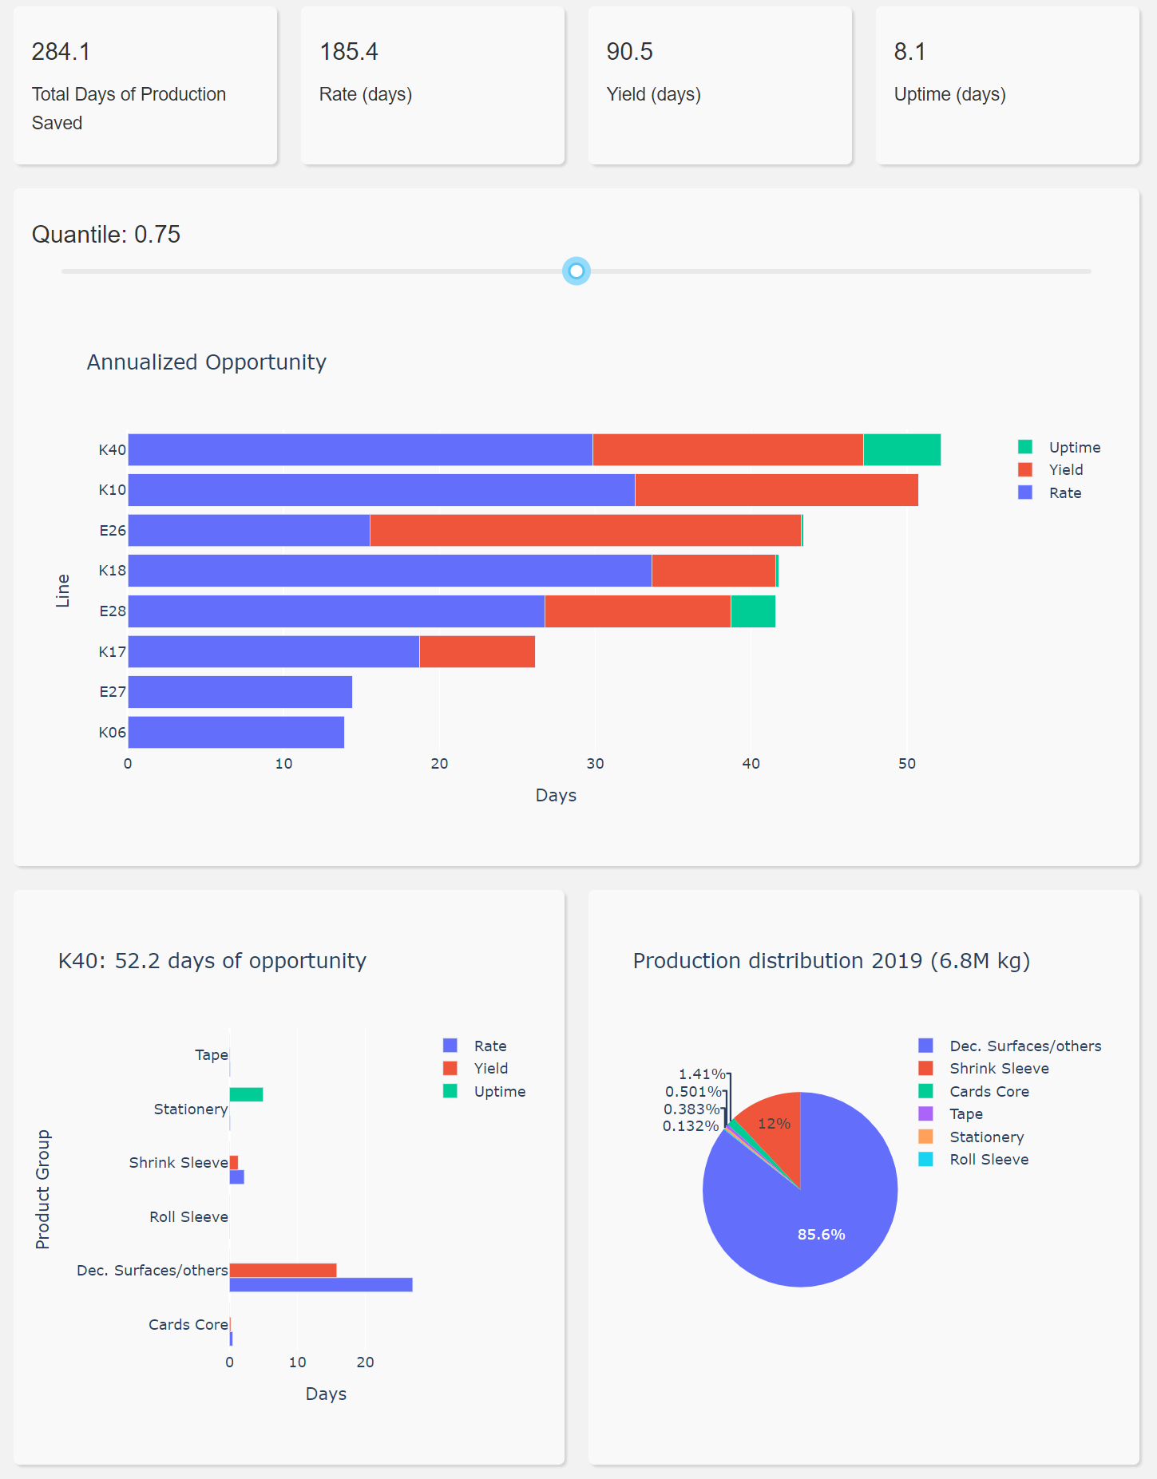
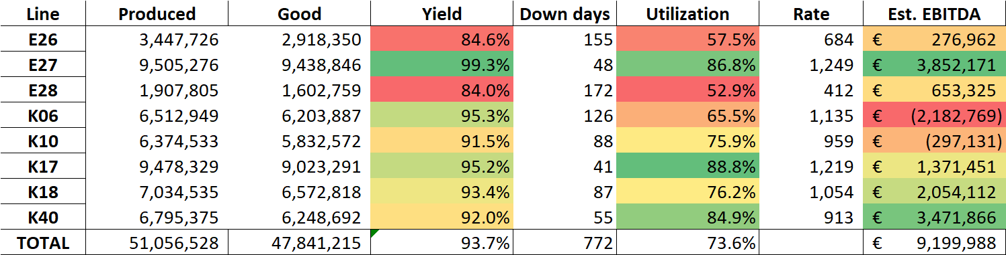
Asset Performance Analysis
Line Performance
If all the lines were running at the P75 vs current mean P50 performance how many days of additional production would I have?
Key Message:
Best Performing lines are E27 and K17 in terms of Yield, Rate and Utilization. K18 & K40 are relatively profitable lines but also have opportunities. This is likely due to a wide variety of products being made on these two lines.
Note: Uptime Opportunity does not include long outages due to NO DEMAND
How does variability in the products contribute to opportunities for a specific line?
Uptime / Utilization
Product distribution for that line
The graph to the left is the total down days for 2019 of the various lines. E27, K40 and K17 are the most utilized. Data was not available to always distinguish demand losses from Failures

Slide 21
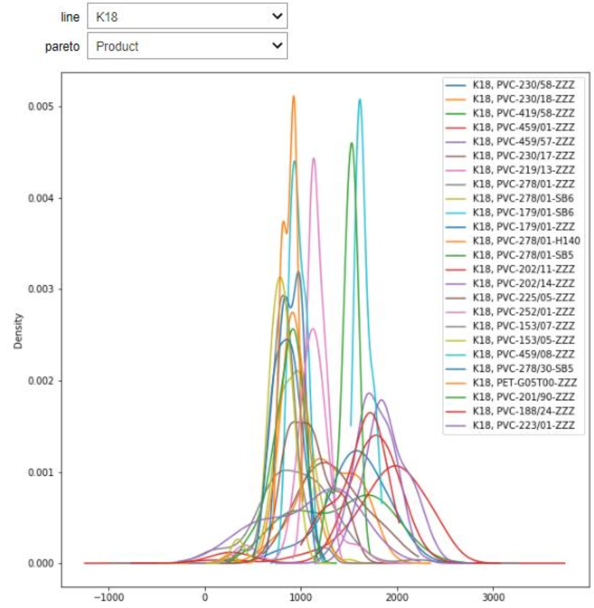
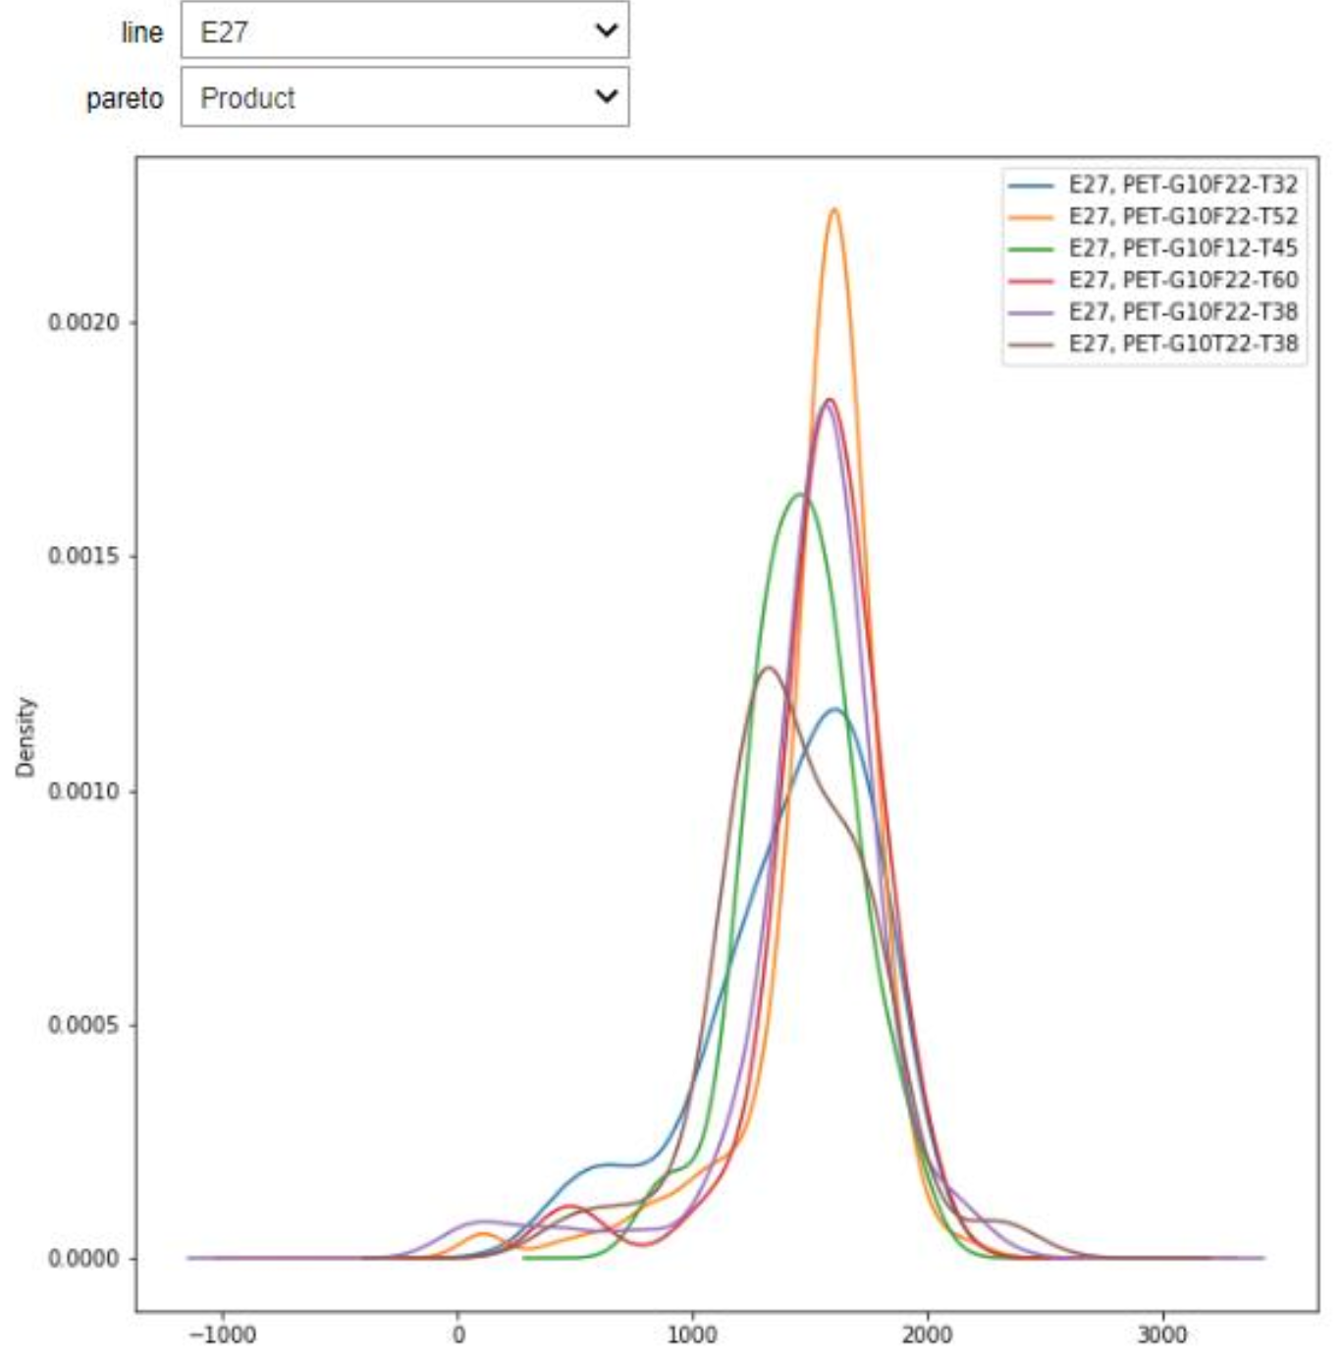
Asset Performance Analysis
Product Variability
The graphs below contrasts product rate distributions for lines K18 and E27. Although, E27 has a small set of products, all the distributions are tall and narrow indicating that the line is run consistently for each product. K18 graph shows a wide variety of products and rates – tall narrow peaks indicate that the product is run consistently. Flat wide distributions are indications of variability in rate thus potentially indicating differences in operating procedures, process issues and / or quality issues.
Key Takeaway: Reducing product variability on rate, yield, quality, SOP’s, etc. is a key method to getting more out of existing assets and driving consistent operations.
Challenging products are indicated by flat wide distributions
Continuous improvement strategy should be to make all distributions tall and narrow. Operations team should work to understand why specific products have wide distributions and are less stable / process capable.
Once products are stable and have consistent tight distribution peaks the objective should be to work to shift the mean – this means what can we do to speed up products? – this in turn unlocks more production capacity

Slide 22
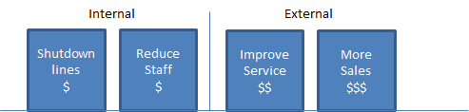
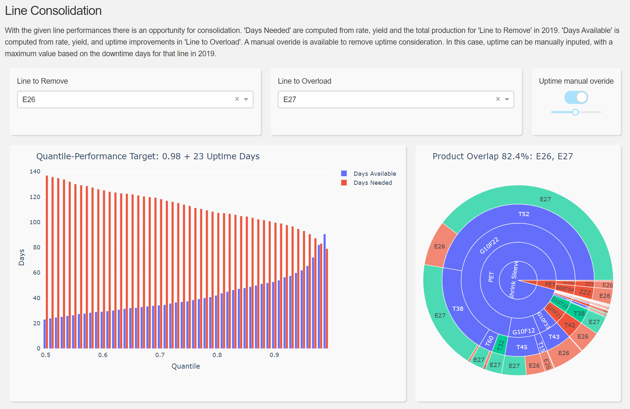
Asset Performance Analysis
Potential Line Consolidations
Ways to monetize underutilized assets.
The site needs to either work with Commercial to fill up underutilized assets or monetize the underutilization by consolidating lines.
Candidates for consolidation are E26, K06, E28, others?
The analysis to the right, evaluates consolidating line E26 into E27. With some improvements in rate and reducing down days – Consolidating the the full E26 portfolio would be tough but doable (82.4% product overlap). Other lines may need to be considered for some of the non-overlapping product such as E28 or some of the low margin products may need to be rationalized.
Consolidating E26 into E27 is worth 1-2 million due to improved yield 84% vs 99% and faster rate / better efficiency (as well as a potential savings of the Fixed Costs of Line E26. Improvement projects that debottleneck E27 so that lines like E26 can be consolidated should be a high priority for OPEX/CI as opposed current work on tracking daily performance.

Slide 23
Asset Performance Analysis
Key Takeaways | Impact
WORK ACROSS NETWORK – There are a lot of under utilized assets across the KPFilms network. This presents an opportunity for Gendorf to work with sister sites and re-distribute product loading of lines so that underutilized assets are consolidated | UNKNOWN
DEBOTTLENECK E27 – E27 is a top performing asset at the site however is the key to profitability in Shrink Sleeve. OPEX / CI should aggressively find projects to debottleneck E27 or make it more reliable. Every product that can be run on E27 represents an improvement in Yield, Rate and Cost. Consolidation of line E26 into E27 as well as K06 into E28 (or vice versa) should be explored. | €1 - 2 Million / YR
STABILIZE K40 – K40 is a very profitable line and it appears to be the main line for DECO. K40 also appears to have some relative upside in Rate, Yield and uptime. Variability on Yield and Rate should be understood by product – Cross functional team focused on 5 Why’s? – Objective should be to gain 95% yield (+3%) + 10% improvement in avg. Rate. A Production Engineer Role should help define ideal run rates by product. PET and Polyolefins appear to be less stable then PVC. | €0.5 – 1.0 Million / YR
CHALLENGE CARD AND K10 – The cards business appears to have 77% of the volume with Negative EBITDA. The business should be reviewed, and best options explored to make it more profitable. K10 has a considerable amount of upside. | €0.25 – 0.5 Million / YR
K17 IS A CASH COW – Priorities on K17 should be to drive Yield, Rate and Cost. This business is likely to take care of itself to some degree. The team just needs to focus on Maintain Performance. | €0.1 – 0.25 Million / YR
K18 IS SWING – Of all the lines K18 runs the widest variety of product mix = This likely introduces differences in how the line is run not only by product but by the team itself. This team will have to be very flexible, adapt and have pre-establish SOP’s and conditions for all product families in order to tighten variability. | €0.1 – 0.25 Million / YR
Top Priorities should be E27 Shrink Sleeve and K40 DECO – Total Expected Goal should be: | €2.0 – 4.0 Million / YR

Slide 24
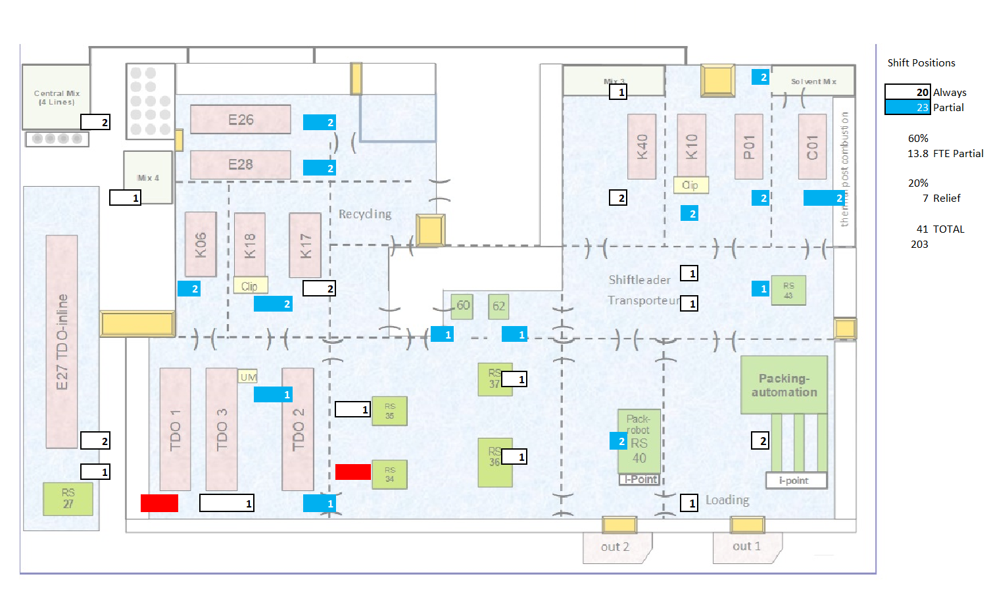
Cost Reduction Opportunities
Operations
Utilization and Resourcing:
FLEXIBLE WORKFORCE
Gendorf has implemented some flexible work crews (blue boxes). They will need to continue to challenge flexibility to remain competitive. Items such as staffing robot packaging areas appear somewhat difficult to justify.
RATIONALIZE LINES WITH LOW UTILIZATION
Bigger opportunities exist when Lines such as E26 and / or K06 can be consolidated.
KEY SUCCESS FACTORS FOR OPERATIONS
Drive performance of K40 and E27 – work with Improvement projects to identify debottlenecking opportunities
Stabilize PET / PO in DECO
Maintenance & Reliability
Maintenance appears to be a cost reduction opportunity. The estimated Maintenance Costs as a %RAV are to the left.
Gendorf currently has:
Work Initiation – No Strong program to ensure work orders are properly written, prioritized
Planning – No real Planning and Scheduling
Scheduling – Shift Mechanics who are not scheduled and perform a lot of non-maintenance activities
Execution – Primarily break fix – Shrinking staff is taking on a lot that should not be maintenance
Reliability just now starting

Slide 25
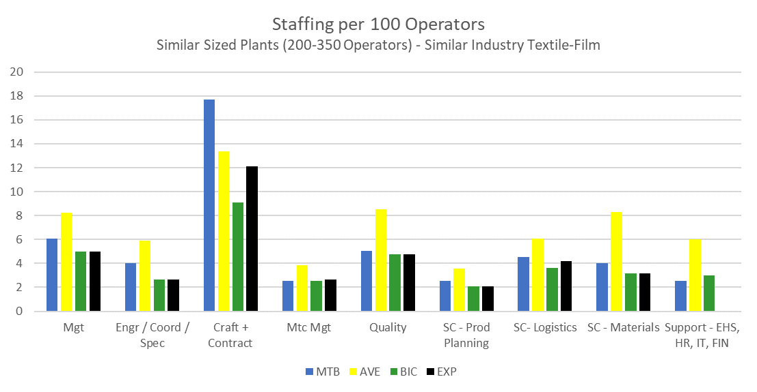
Cost Reduction Opportunities
NOTE: BENCHMARKS ARE USEFUL AND GIVE ORDER OF MAGNITUDE OPPORTUNITY. ULTIMATELY THE APPROACH NEEDS TO FOCUS ON WORK REDUCTION.
Quality
Quality is low as the team is working to migrate tests over to operations
Supply Chain
The current Supply Chain organization is a mix of a wide variety fragmented pieces of the organization such as Site Services and Cleaning (these should report into maintenance)
Support
Full support numbers are unknown as many of these folks have a different reporting structure.
Maintenance & Reliability
Maintenance is an opportunity – FTE Contractors are likely higher than reported as there is an additional maintenance work in MOB Capital. Planning, Scheduling and Kitting are not currently practices. Shift Maintenance craft should be 100% scheduled with Maintenance Work.
Process Engineering, Technical, Coordinators – Numbers are not necessarily an issue but there is needs to be a clearer distinction between Day to Day Support and Strategic Improvement. The site is in need of a clearer Process Improvement Strategy. There are some Day Support SME’s who currently report into OPEX/CI – these should report into Operations.
Operations Management Benchmarks appear reasonable
Confidential

Slide 26
Cost Reduction Opportunities
Key Message | Impact
MAINTENANCE IS THE BIGGEST OPPORTUNITY – Maintenance costs are reported to be roughly €3.3 million / yr (with an additional 3.25 Million in CAPEX) – our understanding is this does not include labor. With labor added maintenance costs are likely €5.0-5.5 Million yr. This is likely a 2.5 to 3.0% of Replacement Asset Value performance. There are currently a lot of non-maintenance activities being performed by maintenance – these items should not be considered maintenance and result in high spend. Non-maintenance activities should be reviewed, and it determined which should be operations responsibilities. Returning non-maintenance activities may result in the ability to insource some outsourced maintenance activities. | €1.0 – 2.0 Million / YR
OPERATIONS – There does not appear to be large opportunities to reduce operators with how the lines are currently run. Bigger opportunities exist when lines are consolidated which is included in the Asset Performance Section | €0.25 – 0.5 Million / YR
SUPPORT – Some minimal cost reductions in Support should be expected as the site gains more efficiency | €0.25 – 0.5 Million / YR
Top Priorities should be E27 Shrink Sleeve and K40 DECO – Total Expected Goal should be: | €1.5 – 3.0 Million / YR
The next section evaluates some best practices to help demonstrate where efficiencies can be gained. It will take some time (1-2 years) for these best practices to be put in place. Consideration should be given to time to implement.

Slide 27
OPERATIONS EXCELLENCE
Operations: BEST PRACTICES - What are we looking for?
Every operator task / activity can be placed in one of the following categories
Typical Indicators of Opportunity
Process or Equipment Monitoring
Example:
Operator Starts Rounds
Applies to Production Plan deviations, Quality Problems, Safety Issues, Equipment to be prepared for maintenance, Roll of Product to be Doffed, Broken fiber, etc.
Lots of Data being collected by Hand
Excessive monitoring without problems ever occurring – long wait times
Equipment Ownership – Operators not performing basic PM, etc.
Operators depending on Technical resources to troubleshoot simple problems
Operators not filling out work requests properly
Operators not preparing work permits or equipment preparation for repair work
Operator knowledge and consistency
Shift to Shift Handover efficiency
Inadequate use of Electronic logs
Inadequate use of standard procedures and protocols
Examples of Non-Value Adding Work being done by Operators or creating additional Non-Value Adding Work for Others
Operator observes issue, troubleshoots and analyzes situation
Situational Awareness
Problem or Task Resolution
Operator fixes problem or performs task
Communication / Historian
Operator documents what was done and communicates

Slide 28
OPERATIONS EXCELLENCE
OPERATIONS FUNDAMENTALS | Observations | BIC Expectations
Safety | Safety is generally seen as a first priority. Gendorf is located within a larger more dangerous chemical site so the organization appears used to higher standards. | Safety is embedded in the culture as a primary driver for all activities, there is recognition of expectations
Equipment Health / Housekeeping | The housekeeping was very good. Some assets like in E27 are in excellent condition and state of the art. Others are mixed vintages and technologies | Process equipment is well maintained, good process containment, repairs are OEM 5S implemented, work areas clear and ergonomic
Leadership | New leadership has made a favorable impression away from the previous Command / Control culture. nto the operations organization. There is still more alignment and clearer goal setting that needs to occur at the leadership level. | Proactive culture in place, goals clearly defined, team working in concert to achieve
Organizational Structure | Organization has started being flexible across lines – Need to work more between groups such as what things should operations do that is currently maintenance responsibility (Ex: basic equipment care). | Structure is designed to provide clear RRE’s for run plant and fix plant and ops has clear equipment ownership
Shop-floor Culture | The operations department has a good team spirit and employees with a lot of energy. With that in mind, there the organization still seems to wait for those in the red jackets to make decisions. More progress has to made to engage the shop-floor and push decision rights deeper into the organization. | Shop-floor that is engaged has the default approach of Resolving Problems myself. Understands basic product economics and owns EHS, yield, uptime, rate and cost.
Continuous Improvement | The OPEX/CI organization is heavily involved in day to day metric tracking with good starts on Visual Factory. Operations should take ownership of the Visual Factory boards and day to day troubleshooting. The site is in need of a clearer Process Improvement path – OPEX should focus defining projects to debottleneck, improve yield, etc. | Clear separation of improvement and run plant responsibilities Resources focused on elimination of re work

Slide 29
OPERATIONS EXCELLENCE
OPERATIONS WORKFLOW | Observations | BIC Expectations
Shift Supervisors and Shift Communications | The shift supervisors have responsibility for the entire operations area. They appear to be very capable and well qualified. The span of control is quite high at 40 per Shift Supervisor. Operations could use a couple of additional roles such as Production Engr, Gatekeeper and Capability leader to take pressure off of the Shift Supervisor. | Working Leads lead the Shift in BIC companies and teams own their areas with efficient, structured communication
Process Monitoring | The site has started Visual Performance Monitoring – This tool can be very effective but should be owned by the Operations shopfloor not OPEX/CI | Performance is tracked and made Visible. Operators have a sense of profitability and costs for poor quality and unreliability.
Problem Resolution | The new leadership team is working to improve this but in general Problems Resolution appears to be led by OPEX/CI vs the shopfloor themselves. The culture still looks for red jacket leaders to make decisions. | First fix attempts made and documented by majority of operators, problem solving is key part of performance review
Historian | There appears to be a large amount of data being collected – There is some analysis being done | Electronic log is utilized as a data base for communications and process improvement
Equipment Ownership | It seems that Maintenance is viewed as the owners of the equipment. There are a lot of non-maintenance activities being performed by Craft that should be owned by operations. The site is in need of a Gatekeeper role to help operators write good work orders, troubleshoot properly before calling maintenance and to own simple equipment care tasks. | Operations decides MTC priority, write equipment permits, hangs first tag, owns the MTC budget, completes standard PM’s and minor repairs

Slide 30
OPERATIONS EXCELLENCE
Maintenance: BEST PRACTICES - What are we looking for?
Maintenance like a project is best planned and front end loaded – Emergency Work costs 3X Planned Work
A good maintenance work process is designed like a series of gates to ensure excessive cost is minimized.
Example:
Broken Equipment identified
Does this really need to be fixed? Can the operator fix it themselves?
Typical Indicators of Opportunity
Work Initiation
Create Valuable Work
Poorly written work request – result in wasted time understanding problem – “fix pump”
Too many simple work requests that could have been done by operator – “replace bulb”
No plans for routine work – results in parts being expedited, equipment not being ready, etc. - Have to staff for unexpected if no plan
Evidence of repeat failures
Little close of work and documentation of what was done in order to improve analysis
Data being collected but little analysis for Mean time between Repairs / Failures (MTBR / MTBF)
Reliability engineers being utilized day to day as opposed to develop proactive equipment strategies
Examples of Non-Value Adding Work
Planning / Scheduling
Where does the work request fall into the set of priorities – How long will it take to fix? What material is needed?
Work Execution
What exactly was done? Is this a repeat failure?
Improvement Cycle (Reliability Analysis)
What can be done to prevent this in the future?

Slide 31
OPERATIONS EXCELLENCE – MAINTENANCE & RELIABILITY
MAINTENANCE WORKFLOW | Observations | BIC Expectations
WORK INITIATION | Work orders are created by MTC, in general are not adequate to communicate what needs to be done or what was done. Production should own the SAP workorder quality and completeness better, too much time is spend by maintenance on “knowing the issues”. | Work orders are created by operations and are screened for value PMs are consistently evaluated for value and approval process is in place to create new PMs
PLANNING | No planning, scheduling and work preparation processes is in place. | Planning is done for all jobs and services, materials and labor is identified
SCHEDULING | Currently no scheduling – Resources should be scheduled 100% even on shift – Emergencies or Break ins are tracked. | All jobs are scheduled using an efficient, easy to read tool and only planned jobs are scheduled
EXECUTION | Craft appear relatively capable but the team has been shrinking and non-maintenance responsibilities growing. There are opportunities to substantially improve maintenance and increase wrench time but they will come when operations and maintenance work out clearer responsibilities between them. Shift craft seem to used as Operations “gopher” as opposed to being 100% scheduled on maintenance activities. | As found as repaired documentation is identified as and expectation in work order closure and closed work orders are evaluated for completeness Checklists/Routines should be evaluated for value as well as transferring some to operations
IMPROVEMENT CYCLE (DATA COLLECTION & INTERFACE TO RELIABILITY) | Site is in need of a dedicated Reliability Engineer role. | Expectations need to be created for data input into Oracle and data need to be analyze to determine preventive measures

Slide 32
OPERATIONS EXCELLENCE – MAINTENANCE & RELIABILITY
MAINTENANCE WORKFLOW | Observations | BIC Expectations
STORES | Spare Parts area is well organized and looks very good. Opportunity to do more kitting. | Stores uses full capability of CMMS and eliminates manual activities Cycle counts are performed on a regular basis Formal process in place to create new inventory items Parts are charged to a section of the equipment to drive cost
Proactive Culture | Processes are primarily reactive and emergency and/repetitive breakdowns do not have a process in place to prevent | Processes are proactive not reactive, a process is in place to analyze each emergency and repetitive breakdowns in order to provide permanent solutions
Failure Management | Failure management is not fully utilized (FMEA,RCM,RBI) – Some being done. | Triggers are established plant wide to identify when FMEA and RCA should be used, RCM is used to prevent failures and RBI are used to determine potential failures
Structured Work Process | Roles are not defined – no clear structured maintenance work process | A structured maintenance work process is in with defined roles
Continuous Improvement | Reactive fix it now mentality, Reliability program is lacking. | Simple RCA are being performed on all reactive and emergency work, job plan feedback is provided

Slide 33
OPERATIONS EXCELLENCE
Gatekeeping Benefits
Work Order Analysis
Gatekeeping Benefits
Current Process
Resource Constrained
Work Initiation
Create Valuable Work
Backlog
Work Requests
Material Procurement
Resource Schedule
Work Requests Generated
Turnaround Scope
Emergency Work
Planning / Scheduling
Expected Process
Value Constrained
Turnaround Scope
Work Execution
Work Requests
Gate
keeping
Planning
Material Procurement
Resource Schedule
Backlog
Non value work not done
Improvement Cycle (Reliability Analysis)
Gatekeeping early in the process will eliminate the non-value added work
Adjustments to the resources should be made based on the value added work demand

Slide 34
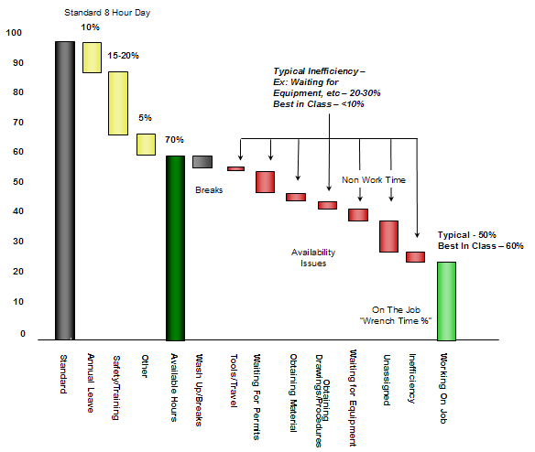
OPERATIONS EXCELLENCE
Maintenance Execution Efficiency
Consistent with Lean –
This is waste
The value of maintenance planning and scheduling is illustrated in the diagram.
Best in Class companies track wrench time (actual time on tools) for craftsmen.
As the diagram indicates a large percentage of a craftsmen time is spend inefficiently waiting for parts, work permits, equipment preparation, etc.
The objective of planning and scheduling is to eliminate as much wait time as possible.
Work Initiation
Create Valuable Work
Planning / Scheduling
Work Execution
Improvement Cycle (Reliability Analysis)
Adapted from Planning Seminar – B. Jacks

Slide 35
OPERATIONS EXCELLENCE
Maintenance Metrics & Improvement
Best in Class companies track the above metrics in order to drive maintenance improvement.
At Gendorf, metrics are not fully tracked and Planning / Scheduling does not really exist.
Work Initiation
Create Valuable Work
Maintenance Metric | Best in Class
Maintenance Cost %RAV | 1.5-2.0%
Spares % RAV | 0.5%
PM + PdM % Work orders | 60
% Planned Work** | 95
MTC Overtime % | 5-7%
Crafts/Planner** | 40
Schedule Compliance, %** | 85
Scheduling Horizon, wks | 3
Work Backlog, weeks | 4-6
PM % by Operators | 25
Standard Job Plans % | 80
RCA % | 100
Wrench Time % | 65-70
Craft Designations | 2-3
Emerg. Jobs (% of work hrs) | 5-10%
Planning / Scheduling
Work Execution
Improvement Cycle (Reliability Analysis)

